Slide 1
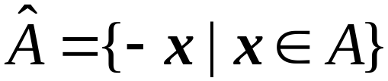
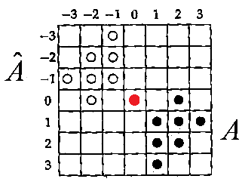
Chapter 10: Mathematical Morphology
Provides mathematical tools for shape analysis in
both binary and grayscale images.
They are suitable to be implemented by hardware.
◎ Basic Operations
○ Reflection
-- Reflects a set of pixels w.r.t. the origin
。 Example:
10-<number>
Notes:
Morphology形態學
A hat 表示A 之reflection
x=(x1,x2)
-x=(-x1,-x2)

Slide 2

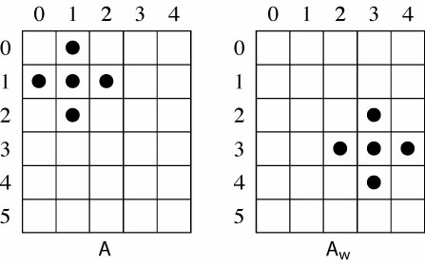



○ Translation
w: a displacement (a vector)
。 Example: w = (2,2)
○ Dilation
: dilation of A by B
B : a structuring element
10-<number>
Notes:
Translation 平移
displacement 位移=!distance距離
dilation擴張
1.不同位移下之A做Unoin(formal)
2.蓋章
3.取A與Bhatx有交集者之Bhatx 5之origin 和A收集起來
Aw1UAw2UAw3…….
structure element-扮演規則的角色

Slide 3
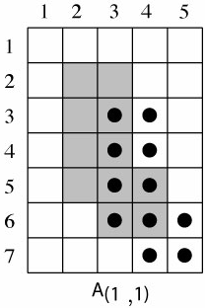
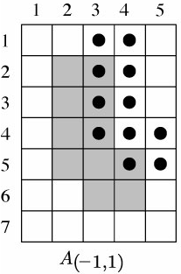
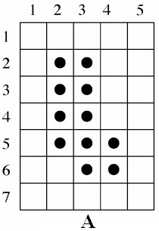
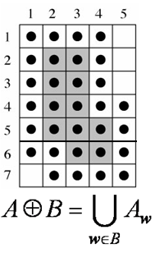
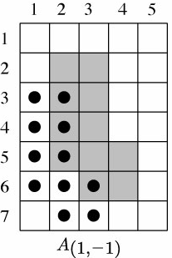
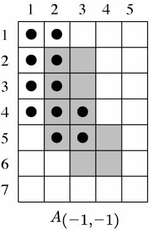
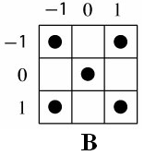
。 Example:
10-<number>

Slide 4

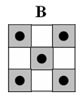
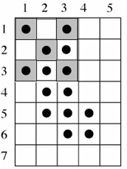
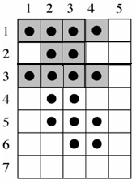
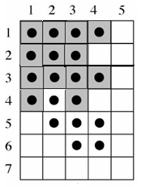
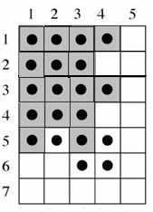
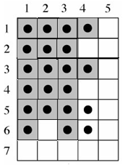
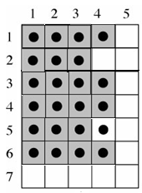
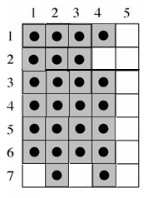
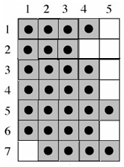
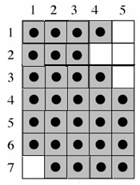
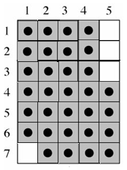
can be obtained by replacing every x in A with a B
10-<number>

Slide 5
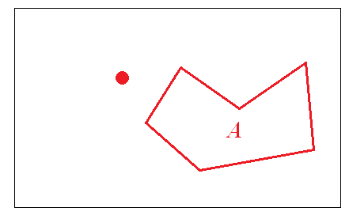
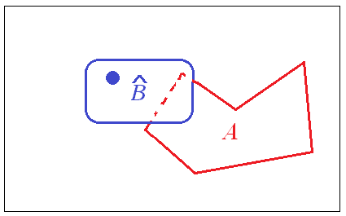


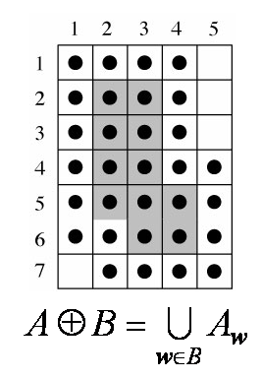
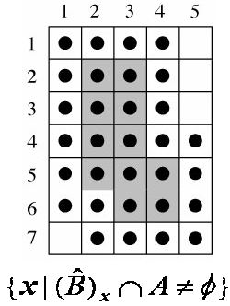
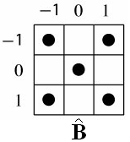
。Example
10-<number>
Notes:
A,B若有交集,則交集不適在A就是在B中
x-位移

Slide 6

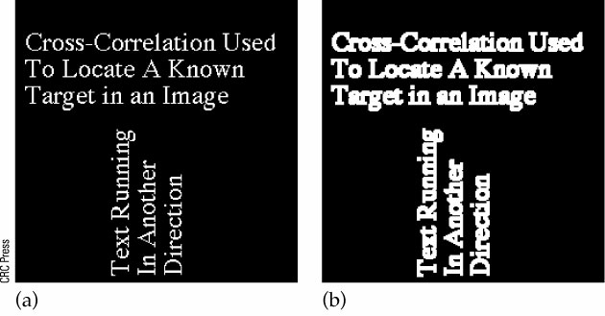
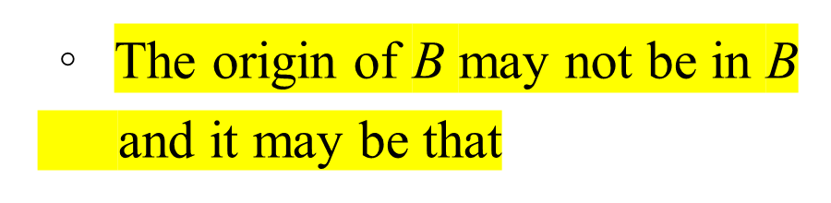

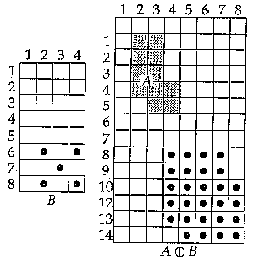
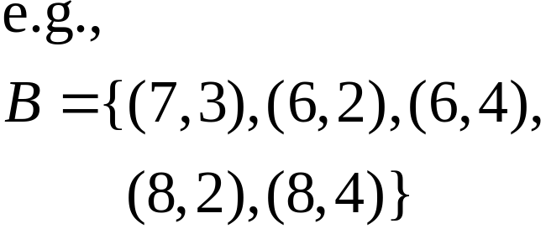
。
。 Dilation has the effect
of increasing the size
of an shape
10-<number>

Slide 7

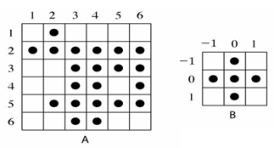
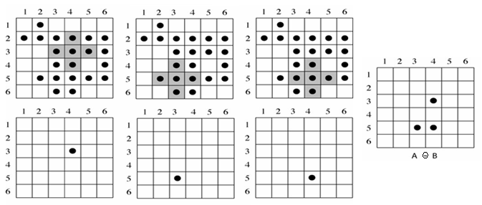
○ Erosion
Steps: (i) Move B over A,
(ii) Find all the places where B fits
(iii) Mark the origin of B when fitting
。 Example:
10-<number>
Notes:
Erosion侵蝕

Slide 8
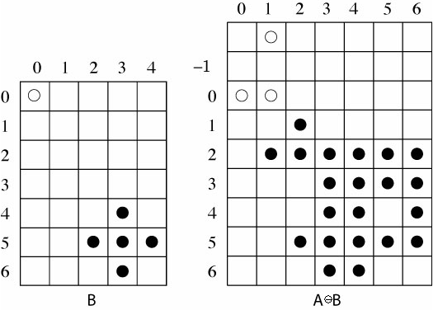

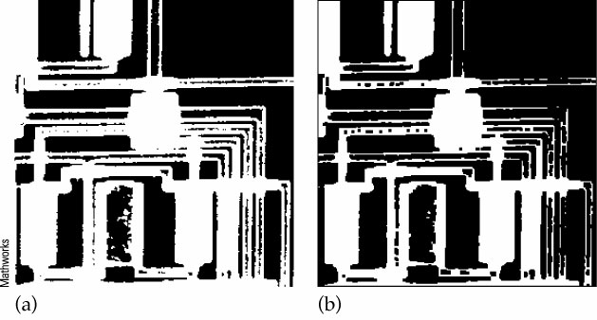
。The origin of B
may not be in B
and
。Erosion thins
an shape
10-<number>

Slide 9





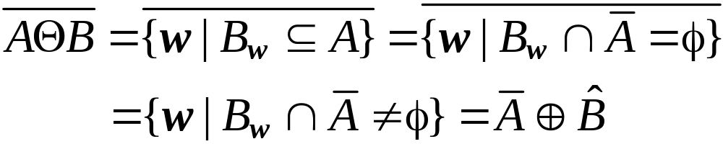
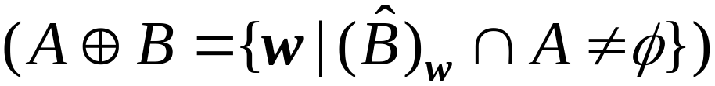

○
Proof: From the definition of erosion,
Its complement:
If , then
。 Duality
(Assigment)
10-<number>

Slide 10



◎ Boundary Detection
Let B: symmetric about its origin
The boundary of A
(i) Internal boundary:
-- pixels in A
(ii) External boundary:
-- pixels outside A
(iii) Gradient boundary:
-- a combination of internal and external
boundary pixels
10-<number>

Slide 11
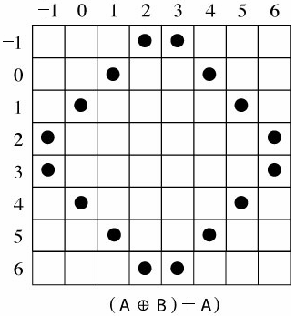
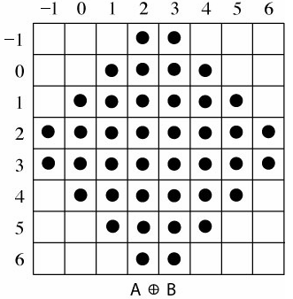
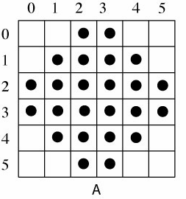
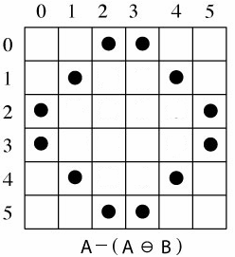
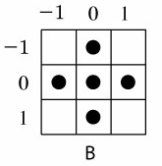
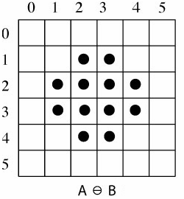
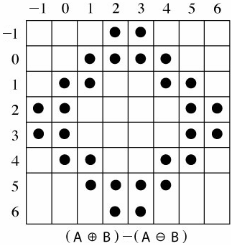
。 Example:
external
boundary
Internal
boundary
gradient
boundary
10-<number>

Slide 12
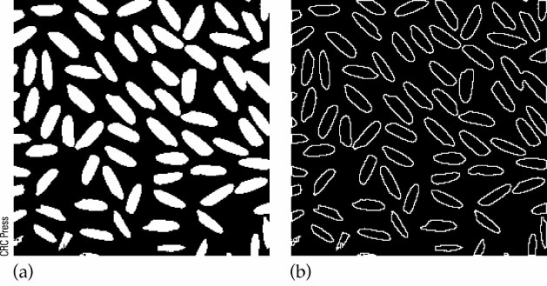
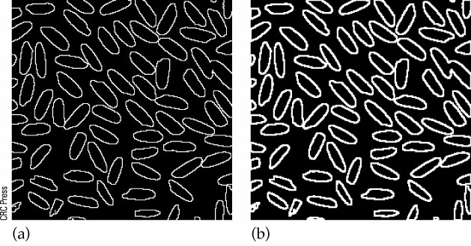
。 Example:
Internal boundary
External boundary
Gradient boundary
10-<number>

Slide 13
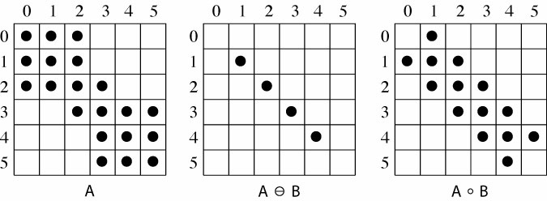
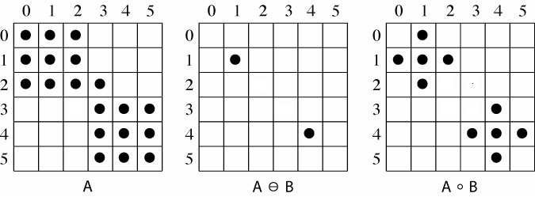
○ Opening
。 Example:
1)
2)
10-<number>

Slide 14


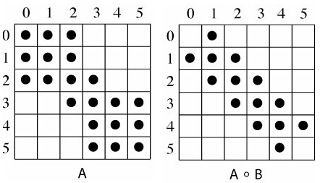
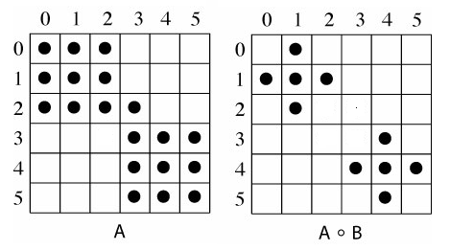
。 Properties:
(i)
(ii) Idempotence:
(iii)
(iv) Opening tends to
(a) smooth shape,
(b) break narrow joins
(c) remove thin protrusions
10-<number>
Notes:
protrusion 突出物

Slide 15

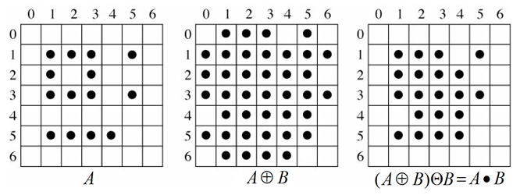
○ Closing
。 Example:
10-<number>

Slide 16



。 Properties:
(i)
(ii) Idempotence:
(iii)
(iv) Closing tends to
(a) smooth shape, (b) fuse narrow breaks
(c) thin gulfs, (d) remove small holes
10-<number>

Slide 17





Show
○ Relationship between opening and closing
Proof:
(Assign.)
10-<number>

Slide 18





◎ Removal of impulse (salt and pepper) noise
Square
Cross
A
B=Square
B=Cross
removes single black and white pixels
but enlarges holes
(2) fills holes by dilating twice
but enlarge the objects
reduces
the size by an erosion
10-<number>

Slide 19










○ Hit-or-Miss Transform -- Finds shape B in A
Example:
(i) (hit)
(ii) (miss)
10-<number>

Slide 20



◎ Region filling
A: a boundary, p : a point within A
10-<number>

Slide 21








Example:
10-<number>

Slide 22

Example:
10-<number>

Slide 23





◎ Connected components
e.g.,
Let A : a collection of components
C : a component of A
p : a point in C
B : a structuring element
Using to find 4-connected components
to find 8-connected components
Connected component
Region filling
10-<number>

Slide 24




Example:
Example:
3 × 3
Structuring
element
11 ×11
Structuring
element
10-<number>
Notes:
4-neighbor-只看4邊不看對角
8-neighbor-看周圍8個
4-connected 是 8-connected的一種,但反過來則否

Slide 25



◎ Skeletonization (thinning)
Applications: OCR , fingerprint recognition,
map digitization.
10-<number>
Notes:
與至少兩個boundary 等距

Slide 26






Optical Character Recognition (OCR)
Fingerprint Recognition
10-<number>

Slide 27


○ Lantuejoul’s method
10-<number>

Slide 28



Example:
Structuring
element
Final
result
10-<number>

Slide 29


Example:
10-<number>

Slide 30



◎ Grayscale Morphology
○ Binary erosion:
(i) Move B over A,
(ii) Find all the places where B fits
(iii) Mark the origin of B when fitting
10-<number>

Slide 31







For each p of A
(i) Find its neighborhood
according to the domain
of B
(ii) p = min{ }
10-<number>
Notes:
Np範圍自己訂,不一定包含Origin

Slide 32




。 Example:
Minimum = 5
10-<number>

Slide 33


Final
result:
10-<number>

Slide 34
。 Summary for the process of grayscale erosion:
For each pixel p of A,
(i) Lie the origin of B over p
(ii) Find according to domain of B
(iii) p = min{ }
10-<number>

Slide 35


。 Example: 5 × 5 square structuring element
＊ Erosion decreases light areas in an image
10-<number>
Notes:
變暗

Slide 36


○ Binary dilation
Replace every x in A with B
10-<number>

Slide 37



For each p of A
(i) Find its neighborhood
according to the domain
of B
(ii) p = max{ }
10-<number>

Slide 38




。 Example:
10-<number>

Slide 39


Final
result:
10-<number>

Slide 40
。 Summary for the process of grayscale dilation:
For each pixel p of A,
(i) Lie the origin of B over p
(ii) Find according to domain of B
(iii) p = max{ }
10-<number>

Slide 41

。 Example: 5 × 5 square structuring element
＊ Dilation increases light areas in an image
10-<number>
Notes:
變亮

Slide 42



◎ Relationship between grayscale erosion and dilation
Let X, Y: matrices,
e.g.,
10-<number>

Slide 43

10-<number>

Slide 44

○ Edge Detection
structure element
3 × 3 square 5 × 5 square
10-<number>

Slide 45



◎ Opening = erosion + dilation
Closing = dilation + erosion
。 Example: 5 × 5 square structuring element
Opening Closing
10-<number>
Notes:
opening-暗、胖
closing-亮、瘦

Slide 46


○ Noise Removal
10-<number>

